Slide 1

Cooper Dahlberg
David Sincyr
Ethan Esber
Kevin Finley
Michael Rumohr
Michael Taylor
Burger Breakout

Slide 2
Overview of Burger Breakout
MUR (4/26): Need to add to overview slide
(1-2 slides)
2D Side Scroller
Featuring running, jumping, fighting, and climbing
Escape the kitchen through various levels playing as a burger
Each level will have different types of obstacles
Throw food and drinks at enemies to help breakout
Watch out for boss fights!
Advance through the levels to unlock different items
Enjoy some catchy background music while playing
Retro pixel theme delivers a nostalgia overload
Hypnotic gameplay with mesmerizing visuals

Slide 3
Some Example User Stories
MUR (4/26): Need to add to overview slide
(1-2 slides)
As a player I want to be able to shoot food so that I can defeat my enemies.
The burger character will be able to shoot different types of food at enemies which complements the game theme and provides a unique game mechanic.
As a player I want to have a character that I can control so that I can move through the world.
The player’s character will be a hamburger that they can control with their inputs.
As a player I want my character to have animations so that the controls feel more realistic.
The character will have basic animations using sprite sheets to give a more realistic, yet retro feel to the game.

Slide 4
Important Functional & Non-Functional Requirements
MUR (4/26): Need to update slide.
(1-2 slides)
x

Slide 5
Important Use Cases
MUR (4/26): Need to update slide.
(2-3 slides)
x

Slide 6
Important Sequence Diagrams
MUR (4/26): Need to update slide.
(2-4 slides)
x

Slide 7
Domain Model and Sequence Diagrams
MUR (4/26): Need to update slide.
(1-3 slides)
x

Slide 8
Architecture Design and Design Patterns Used
MUR (4/26): Need to update slide.
(2-3 slides)
x

Slide 9
Configuration Plans
MUR (4/26): Need to update slide.
(1-2 slides)
x

Slide 10
Summary of Test Plan, Test Cases and Results
MUR (4/26): Need to update slide.
(2-4 slides)
x

Slide 11
Results of Focus Group & Usability Study
MUR (4/26): Need to update slide.
(2-4 slides)
x

Slide 12
Security and Privacy Concerns Addressed
MUR (4/26): Need to update slide.
(2-4 slides)
x

Slide 13
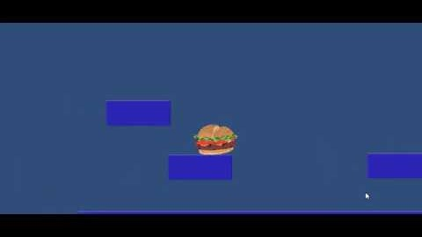
Early mock-up
Still in the early development stage and will add the following features:
Mechanics
Enemies
Hazards
Scenery

Slide 14
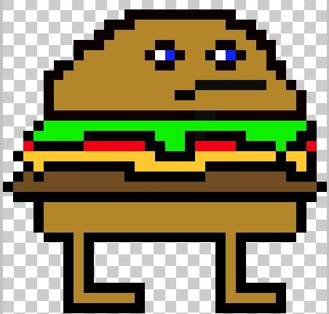
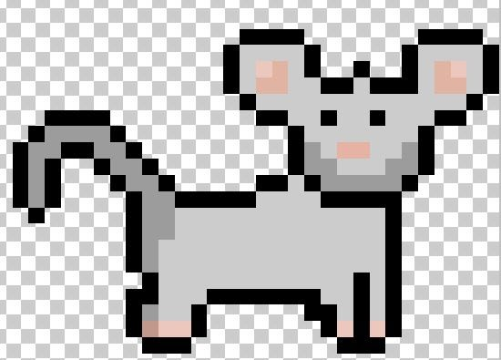
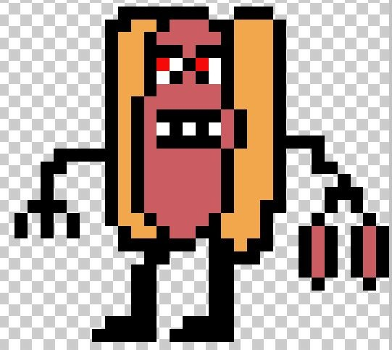
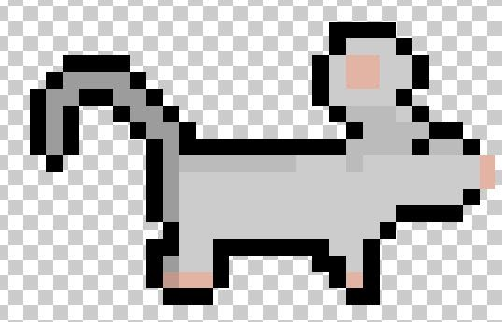
Early Concept Art: Characters
Main Character – needs to be named
Mouse NPC
Hot Dawg Boss –Sausage link Nunchaku wielding

Slide 15
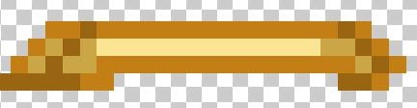



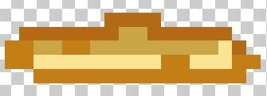
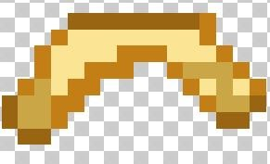
Early Concept Art: Throwable Items
Lettuce
French Fries
Bottom: Fry-a-rang
Fountain Drink

Slide 16


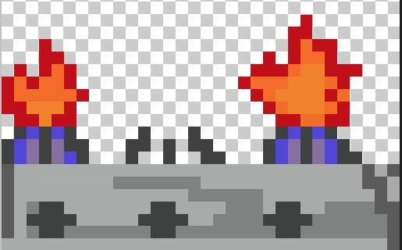

Early Concept Art: Hazards
Dropped Food
Tomato Slices
Timed Jumps Across Kitchen Burners
Knives Being Used by Humans

Slide 17
Breakdown of Level of Effort for Team Members
MUR (4/26): “Who did what and the percentage. A summary of the product backlog can be used.”
(1-2 slides)
x

Slide 18
Work Left on Burger Breakout
MUR (4/26): Need to update slide.
(1-2 slides)
x

Slide 19
Link to Burger Breakout
MUR (4/26): “A link to downloadable application.”
(1 slide)
x

Slide 20

Questions/Comments/Complaints?

